Slide 1
Lecture 30
November 18th , 2019
Thursday---I will be here for the morning lab, but not the afternoon.
All GFP papers due at noon—make arrangements if you have a noon class to turn it in-- in Swain 304.
Thursday will be an independent opportunity to analyze F2 flies. I will help get organized so that each lab will have flies to analyze if possible.

Slide 2
Exam 3 will be proctored by Dr. Lepp or Dr. Halloran Friday.
No class Monday (I’m out of town)—so no class/lab next week!

Slide 3
Homework done!
Now sketch the cross (cross A) that we have set up with our flies and review how we will be able to map the X-linked genes, y, cv, and f.
Try the 3 different orders. Predict DCO offspring in each case. Your understanding of this will make data analysis easy! Be ready.
Do this---ON PAPER. Have it with you next Monday.

Slide 4
Be sure to try the problems linked to the website.
Try this with raw data---insights and solutions p.135 problem 2, and p. 138,problems 14, 15.

Slide 5
Finishing up
3-point crosses need not be set up so systematically…
Can map autosomal genes
Can use organisms of different allele combinations.

Slide 6
Must maintain same criteria:
  One organism must be heterozygous at all loci to be mapped
  Mate to this organism must provide only recessive alleles.
  Analyze lots of offspring to see all examples of XO

Slide 7
Text describes a mapping problem involving 3 linked genes in maize (corn).
  Unknown arrangement of alleles in one mate.
  Homozygous recessive in the other mate

Slide 8
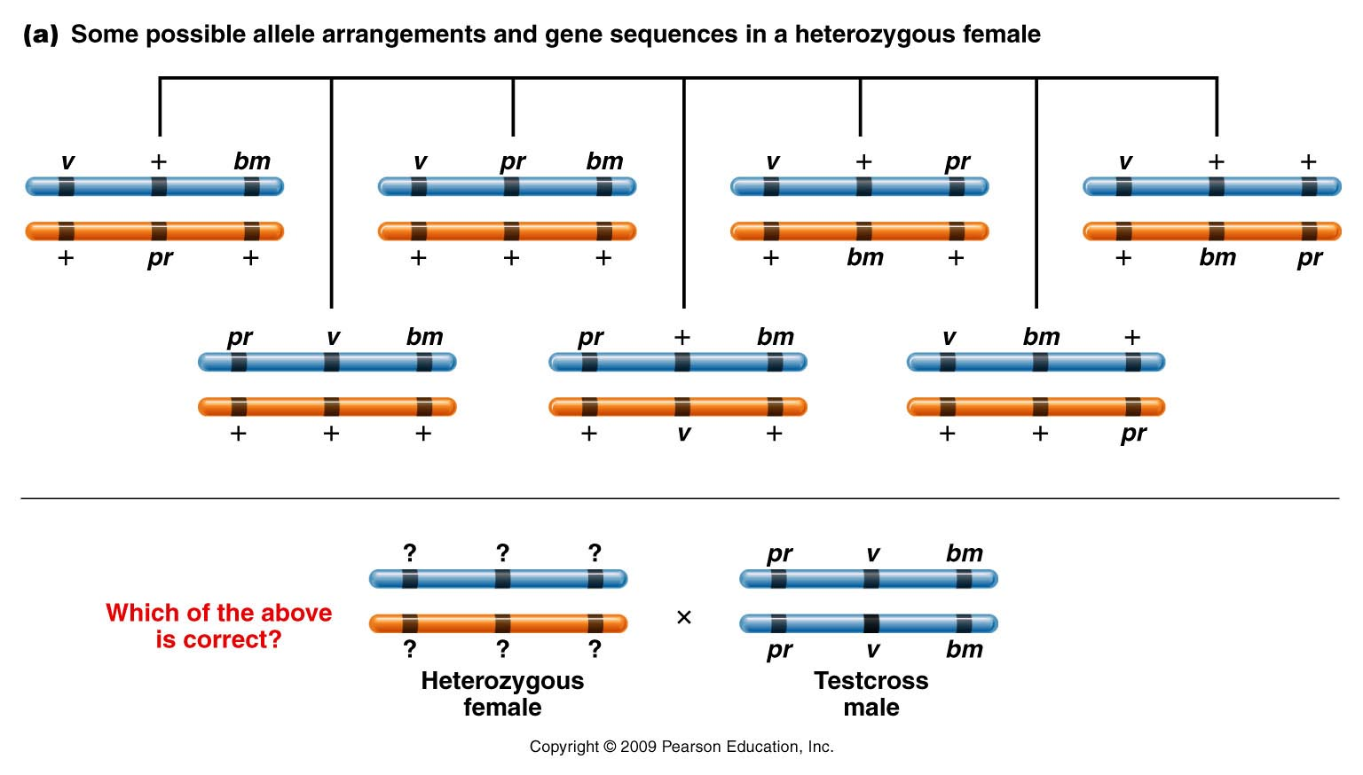
Just means all recessive alleles
Figure 5.10a
Notes:
8
Figure 5-10a (a) Some possible allele arrangements and gene sequences in a heterozygous female. The data from a three-point mapping cross, depicted in (b), where the female is testcrossed, provide the basis for determining which combination of arrangement and sequence is correct. [See Figure 5–11(d).]

Slide 9
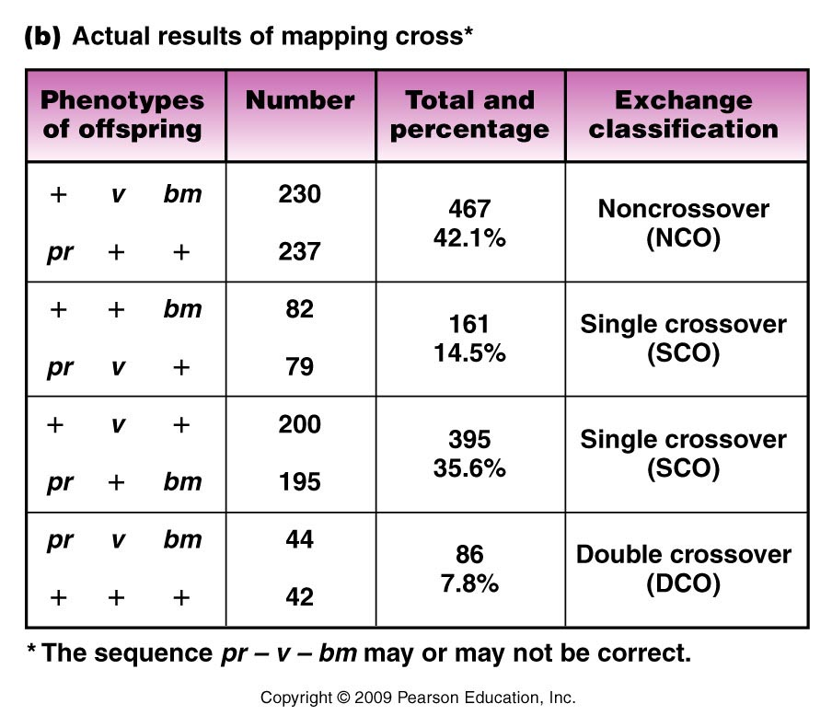
Which classes appear to be NCO?
Which classes appear to be DCO?
Figure 5.10b
Notes:
9
Figure 5-10b (a) Some possible allele arrangements and gene sequences in a heterozygous female. The data from a three-point mapping cross, depicted in (b), where the female is testcrossed, provide the basis for determining which combination of arrangement and sequence is correct. [See Figure 5–11(d).]

Slide 10
Compare
Figure 5.10b
Notes:
10
Figure 5-10b (a) Some possible allele arrangements and gene sequences in a heterozygous female. The data from a three-point mapping cross, depicted in (b), where the female is testcrossed, provide the basis for determining which combination of arrangement and sequence is correct. [See Figure 5–11(d).]

Slide 11
Just draw/sketch the arrangements of alleles until you find an order that works to change NCO to DCO with 2 crossovers.
That reveals the order of the genes.

Slide 12
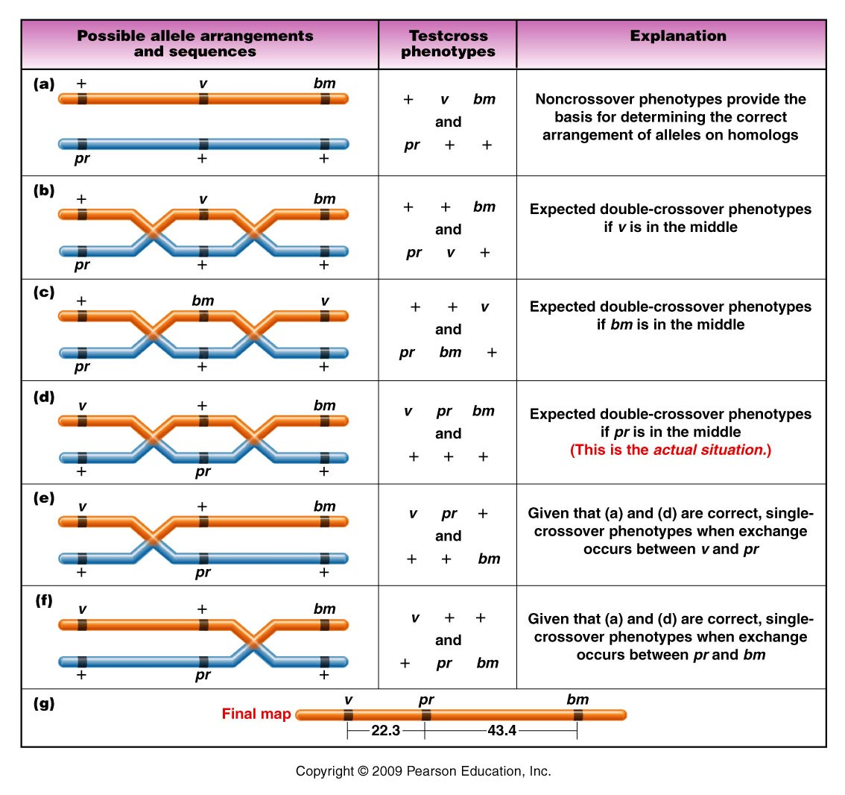
Figure 5.11
Notes:
12
Figure 5-11 Producing a map of the three genes in the cross in Figure 5–10, where neither the arrangement of alleles nor the sequence of genes in the heterozygous female parent is known.

Slide 13
Returning to the map…
v
pr
bm
22.3 cM
43.4 cM
What was the expected frequency of DCO?
(0.223)(0.434) =0.097
9.7% IF….crossover in one interval does not interfere with or enhance crossover in an adjacent interval.....

Slide 14
Observed DCO? 7.8%
Example in which we assume that X.O in one region may have affected (in this case, inhibited) X.O. in an adjacent region.
  Called: INTERFERENCE

Slide 15
We can quantify interference:
  1. determine Coefficient of coincidence
    C = observed DCO
    expected DCO
    C=1 Observed DCO = expected DCO
    C<1 fewer DCO than expected
    C>1 more DCO than expected

Slide 16
Interference (I)=1-C
  C=1 I=0 no interference
  C<1 I>0 positive interference
  C>1 1<0 negative interference

Slide 17
Be sure you review recombination mapping, 3-point mapping, interference.
Problem sets 3 and 4(linkage) is posted on website.
You are expected to understand the book’s examples in chapter 5. Practice analyzing data from 3-point crosses.
  The F2 flies that emerge from your F1 X F1 crosses will give you real data for mapping cv, y, and f.

Slide 18
Returning to Nucleic acid chemistry…
Nucleic acids----DNA and RNA
Both are polymers (repeating units) of nucleotides.

Slide 19
Nucleotides…
3 components
  5-carbon (pentose) sugar
  Nitrogenous base
  PO₄ group(s)
  1 PO₄ group =nucleoside monophosphate
  2 PO₄ groups =nucleoside diphosphate
  3 PO₄ groups =nucleoside triphosphate
Nucleoside

Slide 20
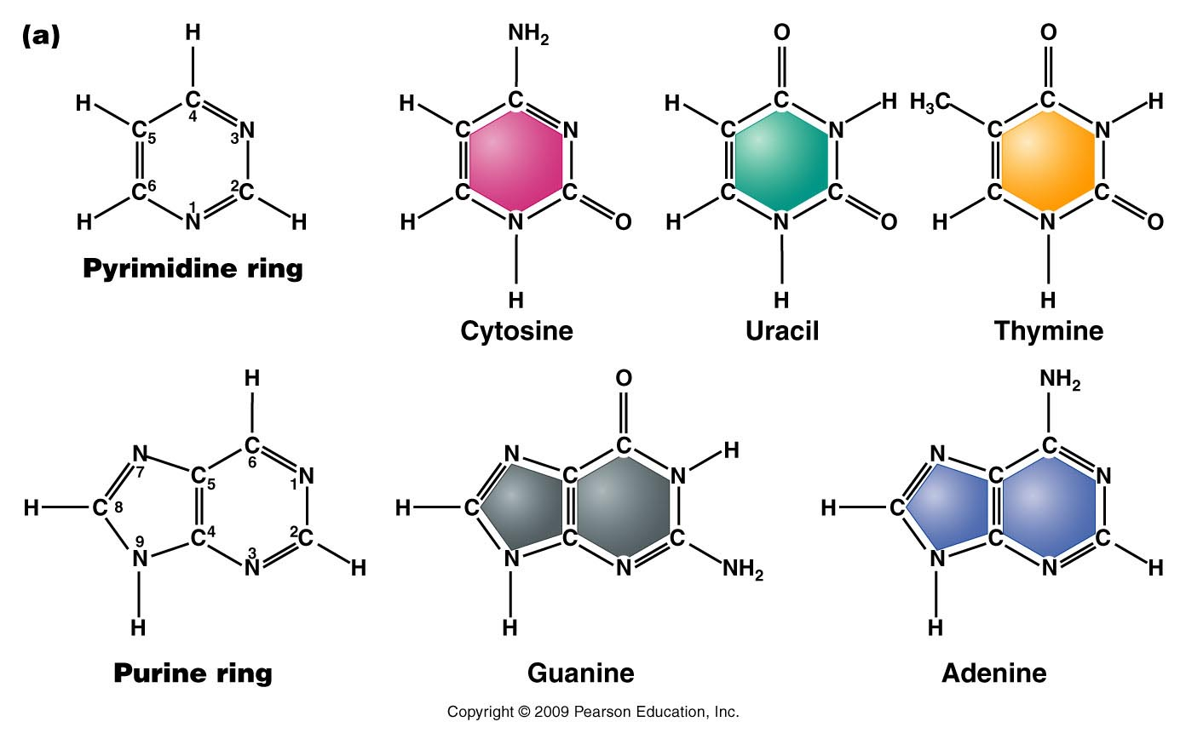
The bases---Do not memorize atomic structure but recognize pyrimidine vs. purine—note all contain nitrogen.
The nitrogen and carbon atoms are numbered.
Figure 10.9a
Notes:
Figure 10-9a (a) Chemical structures of the pyrimidines and purines that serve as the nitrogenous bases in RNA and DNA. The nomenclature for numbering carbon and nitrogen atoms making up the two bases is shown within the structures that appear on the left. (b) Chemical ring structures of ribose and 2-deoxyribose, which serve as the pentose sugars in RNA and DNA, respectively.Web Tutorial 10.1DNA Structure

Slide 21
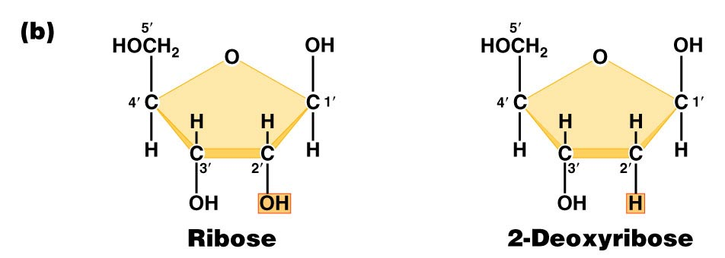
Pentose sugars in RNA and DNA
DRAW THEM!! Note the numbering of atoms
(1’, 2’….carbons).
Found in RNA
Found in DNA
Figure 10.9b
Notes:
Figure 10-9b (a) Chemical structures of the pyrimidines and purines that serve as the nitrogenous bases in RNA and DNA. The nomenclature for numbering carbon and nitrogen atoms making up the two bases is shown within the structures that appear on the left. (b) Chemical ring structures of ribose and 2-deoxyribose, which serve as the pentose sugars in RNA and DNA, respectively.Web Tutorial 10.1DNA Structure

Slide 22
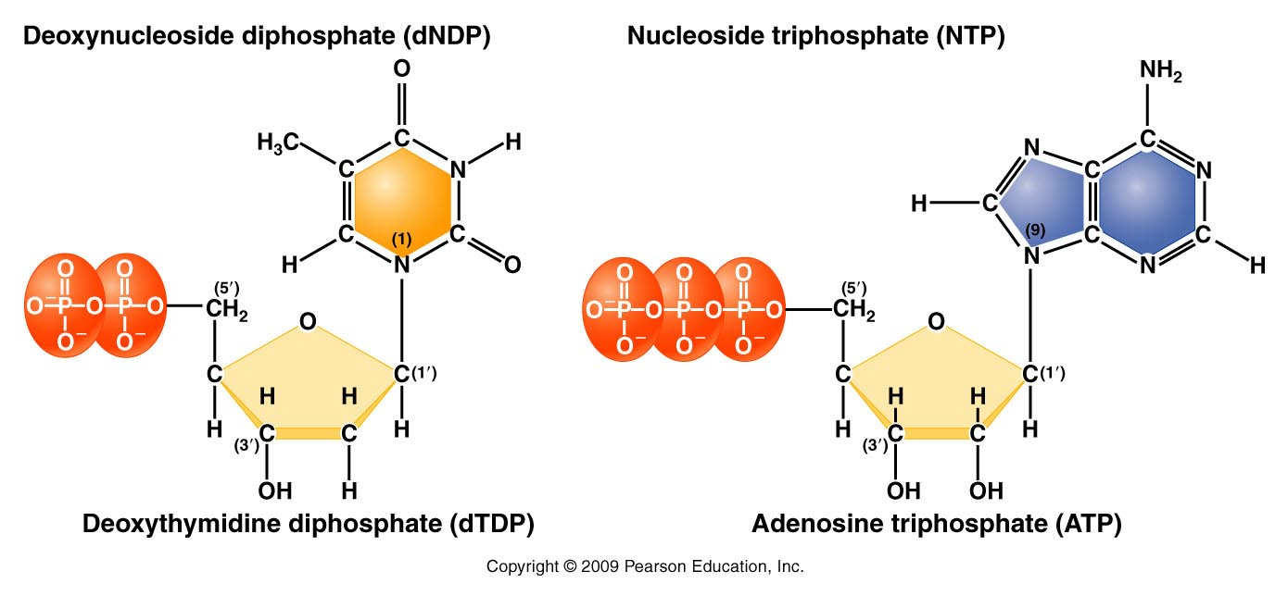
Complete structure of nucleotides
Nitrogenous base forms bond with the 1’ carbon of the sugar
Phosphate forms bond with the 5’carbon of the sugar
d=deoxyribose
no “d”= ribose
Figure 10.11
Notes:
Figure 10-11 Basic structures of nucleoside diphosphates and triphosphates, as illustrated by deoxythymidine diphosphate and deoxyadenosine triphosphate

Slide 23
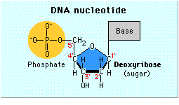
Sketch a nucleotide—show this level of detail
Need not show atomic detail of all bases
Need to show carbon numbering of the sugar
Phosphate groups
Thymine

Slide 24
When talking about any or all RNA or DNA building blocks we us “N” to designate any/all of the bases. For example, dNTP—could be dATP, dCTP, dTTP, or dGTP. If dNPT is plural (dNTPs), we are referring to all 4 DNA nucleotides.
Recognize small differences in structure/chemical make up!
Be sure to be able to distinguish between:
dNTPs and NTPs
dNMPs, dNDPs, dNTPs
Be able to recognize a stretch of RNA from a single strand of DNA….

Slide 25
By the way….Nucleotides serve various functions
Nucleic acid (RNA and DNA) building blocks* (our focus here)
Energy molecules (ATP/GTP)
Signaling molecules (cAMP)

Slide 26
DNA/RNA made of chemically linked nucleotides
Specific type of linkage joins adjacent nucleotides
  5’ carbon of one nucleotide forms a linkage to the 3’ carbon of the adjacent nucleotide
    Phosphate links 2 nucleotides in a phophodiester bond

Slide 27
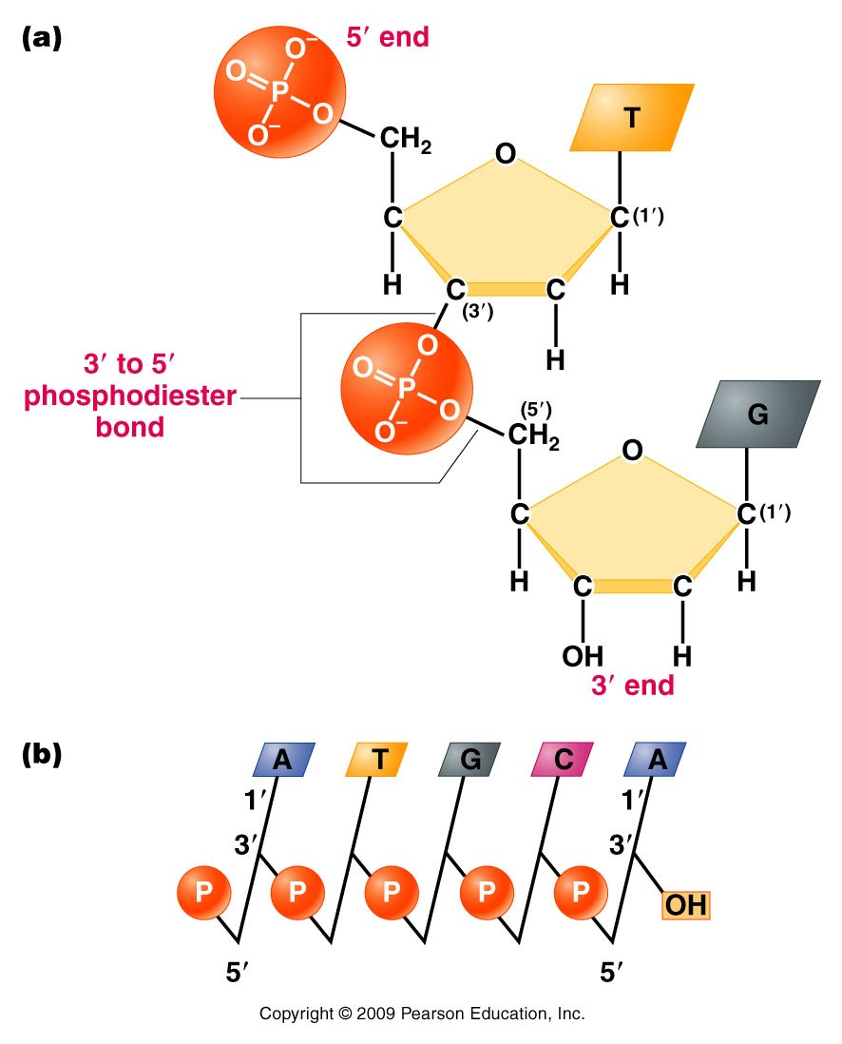
Result is a 5’-3’ linkage and a molecule with 5’ and 3’ ends.
A strand of DNA/RNA
Figure 10.12
Notes:
Figure 10-12 (a) Linkage of two nucleotides by the formation of a C-3’ –C-5’ (3’ –5’) phosphodiester bond, producing a dinucleotide. (b) Shorthand notation for a polynucleotide chain.

Slide 28
RNA exists as a single strand* of nucleotides
DNA is a double strand of nucleotides
  Strands are connected via non-covalent bonds between specific bases.
    Adenine bonds to Thymine
    Cytosine bonds to Guanine
    * adenine and uracil (and cytosine and guanine) can form bonds in regions of an RNA single strand or in DNA-RNA hybrids.
Complementary base pairing

Slide 29
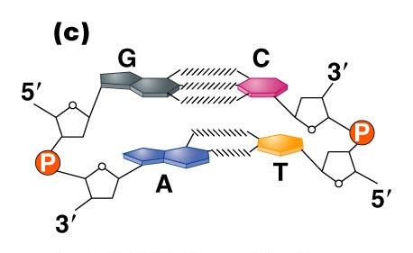
Figure 10.14c
Notes:
Figure 10_14c (a) The DNA double helix as proposed by Watson and Crick. The ribbonlike strands constitute the sugar-phosphate backbones, and the horizontal rungs constitute the nitrogenous base pairs, of which there are 10 per complete turn. The major and minor grooves are apparent. The solid vertical bar represents the central axis. (b) A detailed view depicting the bases, sugars, phosphates, and hydrogen bonds of the helix. (c) A demonstration of the antiparallel nature of the helix and the horizontal stacking of the bases.

Slide 30
Complementary base pairing requires the DNA strands run in opposite directions with respect to 5’ and 3’ ends. (Antiparallel strands)
Complementary base pairing is only possible with a slight twist to each successive base pair. The twisting to accommodate pairing, creates the helical molecule.

Slide 31
(How do we know)? Determining DNA structure…
Double helix is 63 years old!! (knowledge of DNA structure) Published April 25th, 1953.
Watson JD. Crick FHC. A structure for deoxyribose nucleic acid. 1953; Nature 171:737-8.
  Watson and Crick got most of the glory…but the discovery of the structure was a very much a group effort.

Slide 32
It began with biochemical studies…
Erwin Chargaff—studied DNA by base composition.
  Noted roughly equal concentrations of:
    Purines and Pyrimidines
    Specifically: [A] = [T] and [C] =[G]

Slide 33
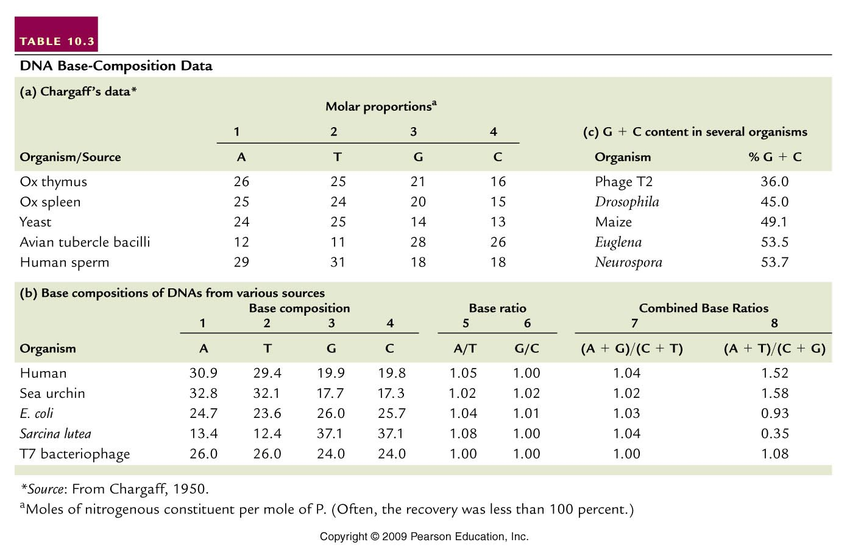
(purines=pyrimidines)
(A+T not = G +C)
Table 10.3
Notes:
Table 10.3 DNA Base Composition Data

Slide 34
  Suggested 1:1 interactions of specific bases.
  A-T and G-C
  Eventually this biochemical ratio supported the specific A-T and G-C base-pairing scheme which facilitates the interaction of 2 DNA strands.

Slide 35
  Interestingly---different species have different base compositions---Some are more A/T rich some are more G/C rich.
  Humans have more A-T base-pairs than G-C base pairs.
  A bacterial species—Sarcinia lutea has more G-C than A-T base pairs.

Slide 36
(purines=pyrimidines)
(A+T not = G +C)
Table 10.3
Notes:
Table 10.3 DNA Base Composition Data

